Slide 1
Data Types in Python Part 4
By Dr Shantanu Pathak
Ref : https://docs.python.org/3/library/stdtypes.html

Slide 2
Contents
Tuple Data type & Operations
Set Data type & Operations
Frozenset Data type & Operations
Dictionary Data type & Operations
Byte Data type & Operations
Bytearray Data type & Operations

Slide 3
Tuple Data Type & Operations

Slide 4
Tuple Data Type
Like a list
Immutable : once created can’t be changed or altered
Special case: if tuple contains mutable object then values inside that mutable object can be changed
Used to pass and return parameters from functions
Can be used to assign multiple values on same line
Because it is immutable it is used to store related values like C structure
Ex. Value of points ( Cartesian Coordinate system)

Slide 5
Tuple Operations
Creation
Use tuple() or direct assignment
To create tuple with single value need comma at end ( special syntax)
Ex. t=(100,) # note there is , after the element
Update / Delete elements : not allowed
Special case : updating mutable elements is possible
Ex. t1 = ( 10, [20,30], 40)
Now t1[1][0] = 100 #allowed
Slicing : just like list or strings
Comparison of two tuples ( < , > , == , >= , <= , != )
Just like in lists and strings ( lexicographical ordering)
Packing and Unpacking
t = 10, 20 , 30 # automatically tuple is created because of packing
a,*b, c = (40,50,60,70) # unpack tuple on right to variables on left side

Slide 6
Common Operations for Sequences (for any sequence Data Types str, list, tuple, bytes, bytearray)
Sr No | Operation | Result
1 | x in s | True if an item of s is equal to x, else False
2 | x not in s | False if an item of s is equal to x, else True
3 | s + t | the concatenation of two sequences, s and t
4 | s * n or n * s | equivalent to adding s to itself n times
5 | s[i] | ith index item of s, origin 0
6 | s[i:j] | slice of s from index i to j
7 | s[i:j:k] | slice of s from index i to j with step k
8 | len(s) | length of s
9 | min(s) | smallest item of s
10 | max(s) | largest item of s
11 | s.index(x[, i[, j]]) | index of the first occurrence of x in s (at or after index i and before index j)
12 | s.count(x) | total number of occurrences of x in s
13 | all(s) | if all values in sequence s are non-zero (TRUE) then return TRUE, else FALSE
14 | any(s) | if any value in sequence s is TRUE then return TRUE else return FALSE

Slide 7
Extra for Tuple
Working on zip() function
How to loop over 2 or more lists using ONLY one ‘for’ statement ?

Slide 8
Set Data Type & Operations
And Frozenset

Slide 9

Set Data Type
set is an unordered collection with no duplicate elements.
Internally uses hashing to determine the duplicate elements
Just like a set in algebra
Set can be changed, so its mutable
Set allows ONLY hashable (immutable) elements
Single element of set cannot be updated
ONLY immutable elements are allowed
Single element cannot be updated
Set doesn’t maintain insertion order of elements so its un-ordered
Order of elements is decided based on hash value of the elements
So, indexing, slicing and many other sequence like behavior are NOT ALLOWED
Creating Set:
Set can be created using set() constructor passing any iterable

Slide 10
Set Comprehension
Set comprehension is similar to list comprehension
Curly brackets are used to denote the comprehension
Here all elements are added to set at once without calling add() function each time
Ex. Create set of all values between 1 to 15, which are greater than 5

Slide 11
Common Use of sets
membership testing
removing duplicates from a sequence
computing mathematical operations such as
Intersection
Union
Difference
Symmetric difference

Slide 12

Frozenset Data Type
It is Immutable set
Can be used inside a set as an element
Can be used as key for dictionaries (discussed ahead)
Frozenset is hashable object because it is immutable
Once it is created addition or removing or elements is not possible
All other rules are same as set
Created using constructor frozenset()

Slide 13
Common Operations for Set / Frozenset
Sr No | Operation | Result
1 | x in s | True if an item of s is equal to x, else False
2 | x not in s | False if an item of s is equal to x, else True
3 | len(s) | length of s
4 | min(s) | smallest item of s
5 | max(s) | largest item of s
6 | all(s) | if all values in sequence s are non-zero (TRUE) then return TRUE, else FALSE
7 | any(s) | if any value in sequence s is TRUE then return TRUE else return FALSE
8 | s1.union(s2) or s1 | s2 | Union of two sets
9 | s1.intersection(s2) or s1 & s2 | Intersection of two sets
10 | s1.difference(s2) or s1 – s2 | Difference between sets
11 | s1.isdisjoint(s2) | Check if two sets are dis-joint sets or not
12 | s1.issubset(s2) or s1 < s2 | Check if s1 is subset of s2
13 | s1.issuperset(s2) or s1 > s2 | Check if s1 is superset of s2
14 | s1.copy() | Create shallow copy of set s1
 | SLICING IS NOT SUPPORTED

Slide 14
Common Operations for Set / Frozenset
Sr No | Operation | Result
15 | s1.symmetric_difference(s2) or s1 ^ s2 | Get symmetric difference between s1 and s2
Common Operations ONLY for Set
Sr No | Operation | Result
16 | s1.clear() | Remove all elements from set s1
17 | s1.add(element) | Add element to a set
18 | s1.remove(element) | Remove element or set of elements from a set if present else raise KeyError
19 | s1.discard(element) | Remove element or set of elements from the set if it is present.
20 | s1.pop() | Remove and return arbitrary element from set and raise KeyError is set is empty
21 | s1.update(s2) or s1 |= s2 | s3 | .. | Update the set, adding elements from all others.
22 | s1.intersection_update(s2) or s1 &= s2 & s3 & .. | Update the set, keeping only common elements found in it and all others
23 | s1.difference_update(s2) or s1 -=s2 | Update the set, removing elements found in others.
24 | s1. symmetric_difference_update(s2) or s1 ^= s2 | Update the set, keeping only elements found in either set, but not in both.

Slide 15
Dict (Dictionary) Data Type & Operations

Slide 16
Dict (Dictionary)
Dictionary is ordered collection of key:value pairs, where all keys are non-duplicate
In other languages it is HashMap or HashTable or associative arrays
Recently dictionaries are Ordered after Python 3.6+ , before they were unordered
Order is based on insertion of keys
Dictionary is mutable
Key can be any non duplicate and immutable element
ONLY int/float/complex/bool/string/tuple/frozenset are allowed as key
Tuple having mutable element directly or indirectly are not allowed as keys
Value can be any data type and mutable
Dict is ordered means sequence of elements same as sequence in which they are added
Search of key happens by using hash function, which is very efficient search

Slide 17
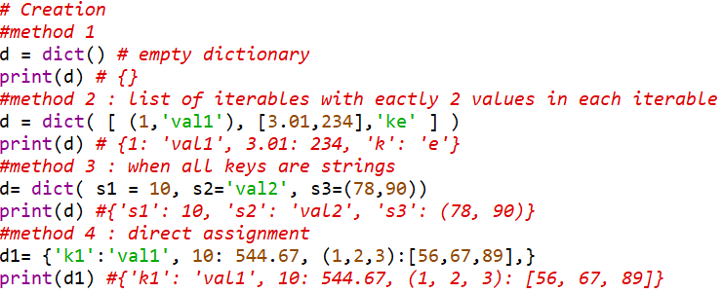
Dictionary common operations
dict() constructor -> creates dictionary
Note: if same key occurs more than once then existing value is replaced by new one

Slide 18
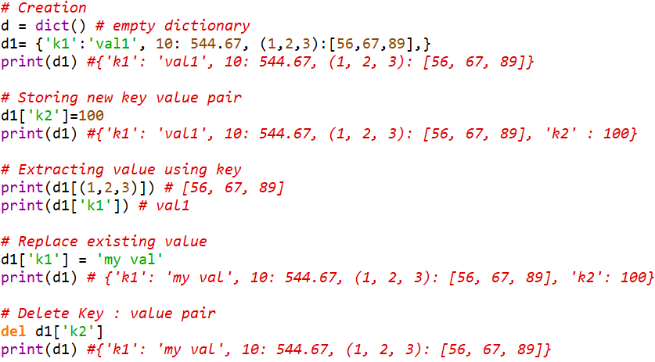
Dictionary common operations

Slide 19
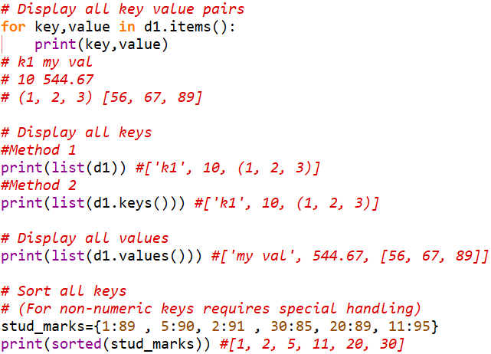
Dictionary common operations

Slide 20
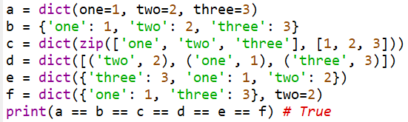
Dictionary common operations
Equality of Dictionaries ( == , != )
Two dictionaries are considered equal if both have all key:value pairs same
Sequence of key:value pairs doesn’t matter in equality
NOTE : Other comparisons are not supported for dictionaries

Slide 21
Dictionary common operations
Sr No | Operation | Result
1 | x in d | True if key of d dictionary is equal to x, else False
2 | x not in d | False if key of d dictionary is equal to x, else True
3 | len(d) | Return the number of items in the dictionary d.
4 | min(d) | smallest key of d dictionary #NOT supported if different type of keys
5 | max(d) | largest key of d dictionary #NOT supported if different type of keys
6 | all(d) | if all key of d dictionary are non-zero (TRUE) then return TRUE, else FALSE
7 | any(d) | if any key of d dictionary is TRUE then return TRUE else return FALSE
8 | list(d) | Return a list of all the keys used in the dictionary d.
9 | d[key] | Return the item of d with key key. Raises a KeyError if key is not in the map.
10 | d[key] = value | Set d[key] to value if key exists else add new key:value pair at end of dictionary. #Note if key already exists then its order is not affected
11 | del d[key] | Remove d[key] from d. Raises a KeyError if key is not in the map.
12 | iter(d) | Return an iterator over the keys of the dictionary. This is a shortcut for iter(d.keys()).

Slide 22
Dictionary common operations
Sr No | Operation | Result
13 | d.clear() | Remove all elements (key value pairs) from a dictionary
14 | d.copy() | Return shallow copy of dictionary d
15 | dict.fromkeys(iterable[, value]) | Create dictionary from keys in iterable and all keys are given same value. NOTE: Don’t use mutable object as value here!
16 | d.get(key[, default]) | Return the value for key if key is in the dictionary, else default. If default is not given, it returns None, never raises a KeyError.
17 | d.items() | Return a new view of the dictionary’s items ((key, value) pairs).
18 | d.keys() | Return a new view of the dictionary’s keys.
19 | d.pop(key[, default]) | If key is in the dictionary, remove it and return its value, else return default. If default is not given and key is not in the dictionary, a KeyError is raised.
20 | d.popitem() | Remove and return a (key, value) pair from the dictionary. Pairs are returned in LIFO order. If the dictionary is empty, calling popitem() raises a KeyError. It is used to destroy items of dictionary one by one
21 | reversed(d) | Return a reverse iterator over the keys of the dictionary. This is a shortcut for reversed(d.keys()). Python 3.8+

Slide 23
Dictionary common operations
Sr No | Operation | Result
22 | d.setdefault(key[, default]) | If key is in the dictionary, return its value. If not, insert key with a value of default and return default. If default not given then use None.
23 | d.update([other]) | Update the dictionary with the key/value pairs from other dictionary, overwriting existing keys. Return None. It accepts either another dictionary object or an iterable of key/value pairs (as tuples or other iterables of length two). If keyword arguments are specified, the dictionary is then updated with those key/value pairs: Ex. d.update(red=1, blue=2)
24 | d.values() | Return a new view of the dictionary’s values.
25 | d | other_dict | Create a new dictionary with the merged keys and values of d and other_dict, which must both be dictionaries. The values of other_dict take priority when d and other_dict share keys. Python 3.9+
26 | d |= other | Update the dictionary d with keys and values from other, which may be either a mapping or an iterable of key/value pairs. The values of other take priority when d and other share keys. Python 3.9+
 | SLICING | NOT Supported in dictionaries

Slide 24
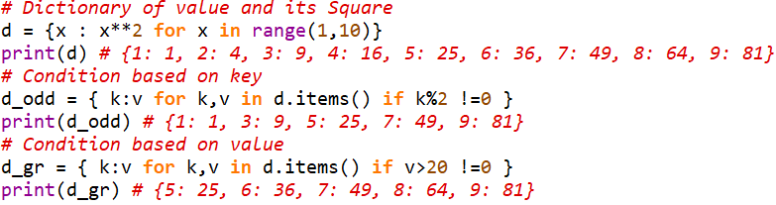
Dictionary Comprehension
Used to create dictionaries faster than adding elements in a loop
Code is included in braces
Syntax -> { <key> : <value> for x in … }
It can be used to select elements from other dictionary using condition

Slide 25
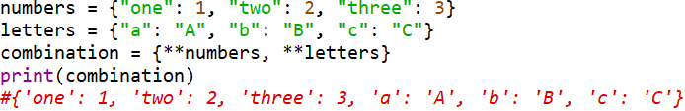
Dictionary packing and Unpacking
‘**’ suffix to a variable is used as dictionary unpacking operator
Good Ref for packing and unpacking in list, tuple, set and dictionary
https://stackabuse.com/unpacking-in-python-beyond-parallel-assignment/

Slide 26
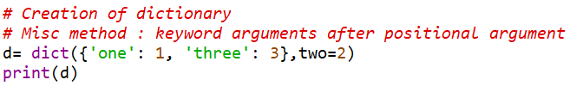
Dictionary Extra
How to create dictionary using two separate lists one having all keys another having all values ?
How dictionary maintains order and why?
https://stackoverflow.com/questions/50872498/will-ordereddict-become-redundant-in-python-3-7
Another Method to create dictionary :

Slide 27
Dictionary View Objects (Extra)
The objects returned by dict.keys(), dict.values() and dict.items() are view objects.
They provide a dynamic view on the dictionary’s entries, which means that when the dictionary changes, the view reflects these changes.
Dictionary views can be iterated over (iterable)
Support membership tests (in and not in operations)
len() , iter(), reversed() are supported by this
Ex. list(reversed(d.items()))
len(d.values())

Slide 28
Extra material

Slide 29
Extra
Size of different data types in Python
https://stackoverflow.com/questions/449560/how-do-i-determine-the-size-of-an-object-in-python/30316760#30316760

Slide 30
Byte Data Type and Operations

Slide 31
Byte Data Type
Ref :
https://docs.python.org/3/library/stdtypes.html#bytes-objects
https://docs.python.org/3/library/functions.html#func-bytes
Operations
Most of the operations of strings are applicable here
https://docs.python.org/3/library/stdtypes.html#bytes-and-bytearray-operations

Slide 32
Bytearray Data Type

Slide 33
Bytearray Datatype
Mutable counter parts of bytes objects
They are always create by calling the constructor bytearry()
bytearray() has three parameters source, encoding, errors
The optional source parameter can be used to initialize the array in a few different ways:
If it is a string, you must also give the encoding (and optionally, errors) parameters; bytearray() then converts the string to bytes using str.encode()
If it is an integer, the array will have that size and will be initialized with null bytes.
If it is an object conforming to the buffer interface, a read-only buffer of the object will be used to initialize the bytes array.
If it is an iterable, it must be an iterable of integers in the range 0 <= x < 256, which are used as the initial contents of the array.
Without an argument, an array of size 0 is created.

Slide 34
Bytearray Functions
It has most of the usual methods of mutable sequences, described in Mutable Sequence Types (List)
Operations
Most of the operations of strings are applicable here
https://docs.python.org/3/library/stdtypes.html#bytes-and-bytearray-operations

